Slide 1
Building Tools with PowerShell
Based off of PowerShell Toolmaking Fundamentals
By: Adam Bertram

Slide 2

PS> whoami
PowerShell MVP
Independent Consultant
Freelance Writer
Trainer – Hire Me!
Blogger: adamtheautomator.com
Twitter: @adbertram

Slide 3
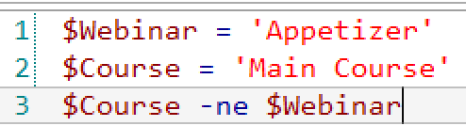
Just a Teaser

Slide 4
The Evolution of Toolmaking
Script
Console
Tool

Slide 5
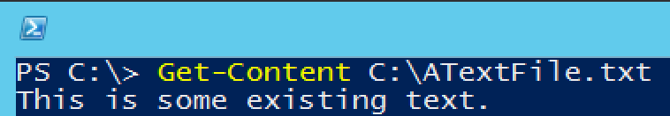
The Console
The Console:
Example
Is a Learning Tool
Is a Management Tool
Is the Home of the One-Liner

Slide 6
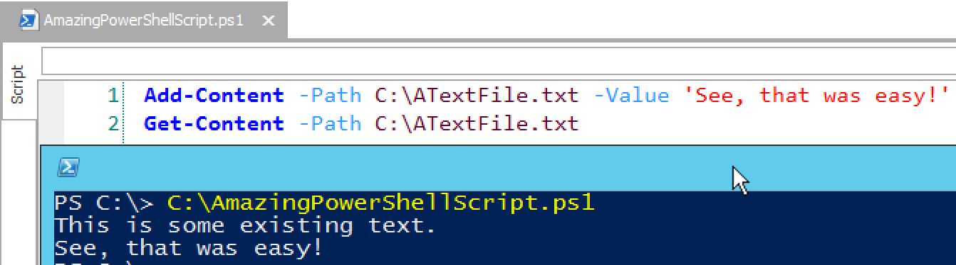
A Script
A Script:
Example
Solves an Immediate Problem
Just Gets it Done
Has Little Regard for Variances

Slide 7

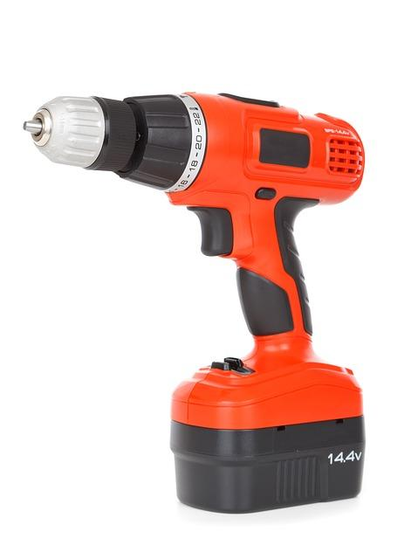
A Tool
A Tool:
Is Created from Necessity
Is Built to Last
Error Handling
Makes no Assumptions
Help/Comments
Is Reusable
Requires Minimal Changes

Slide 8
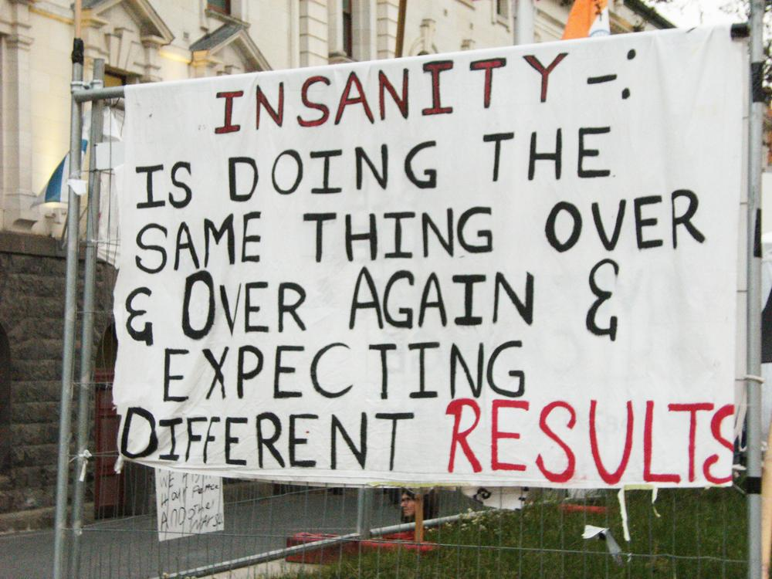
When to Build a Tool
Notice Repetitive Tasks
Recognize Workflows

Slide 9
Tool Requirements
Config Items:
Steps:
By default:
user accounts get created in the Corporate Users OU.
Computer accounts get created in the Corporate Computers OU
Users get placed in the Gigantic Corporation Inter-Intra Synergy Group group
Default can be overridden by CSV entry
User accounts need to be first initial and last name. If that’s taken, first initial, middle initial and last name
Read employees from CSV file.
Figure out username.
Create user account.
Add user to a default group.
Create computer account.

Slide 10
DEMO
The Active Directory Account Automator
Material Available At: http://bit.ly/pluralsighttools

